Slide 1
Science of Living System
BS20001
Ritobrata Goswami
School of Bio Science
Email: ritobrata.goswami@iitkgp.ac.in
Tel: 03222-260518

Slide 2
Lecture | Date | Topic
1 | 03/01/2018 | Nucleic acids – 1
2 | 10/01/2018 | Nucleic acids – 2
3 | 17/01/2018 | Transcription and Translation – 1
4 | 24/01/2018 | Transcription and Translation – 2
5 | 31/01/2018 | Protein structure – 1
6 | 07/02/2018 | Protein structure – 2 / Discussion and Revision
** | 14/02/2018 | CLASS TEST - 1
7 | 28/02/2018 | Enzymes
8 | 07/03/2018 | Cellular architecture
9 | 14/03/2018 | Cell division and apoptosis
10 | 21/03/2018 | Host defense/vaccines
11 | 28/03/2018 | Genetic Engineering & its impact
** | 04/04/2018 | CLASS TEST - 2
** | 11/04/2018 | DISCUSSION AND REVISION

Slide 3
Protein Structure, Function, Kinetics and Energetics
Books Followed:
How Proteins Work (Mike Williamson)
Introduction to protein structure (Carl Branden & John Tooze)
Biochemistry (Lubert Stryer)

Slide 4
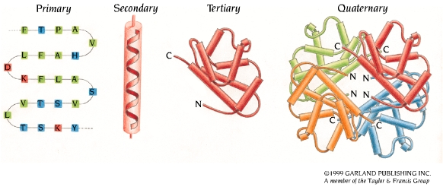
Hierarchy of Protein Structure

Slide 5
Protein classification by function
Enzymes: catalyze chemical reactions.
Regulatory proteins: bind to protein receptors, e.g. hormones such as insulin.
Transport proteins: e.g. myoglobin and hemoglobin transport O₂.

Slide 6
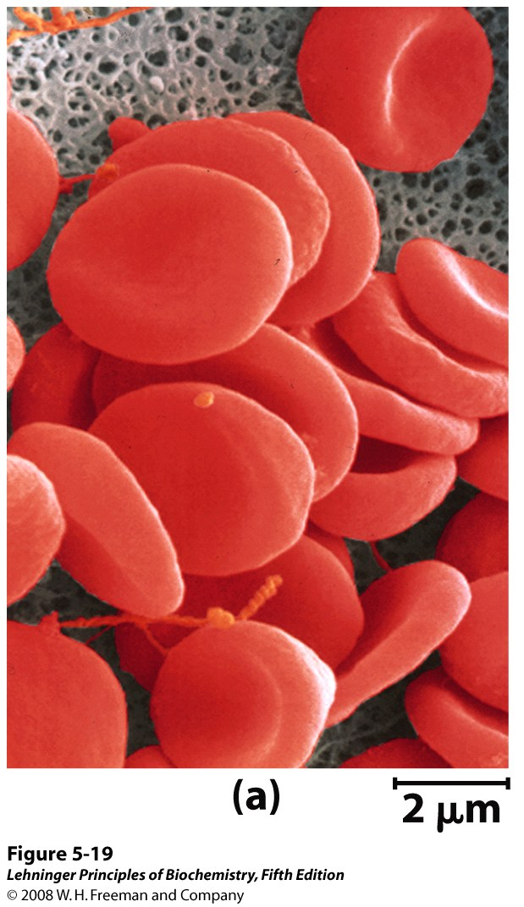
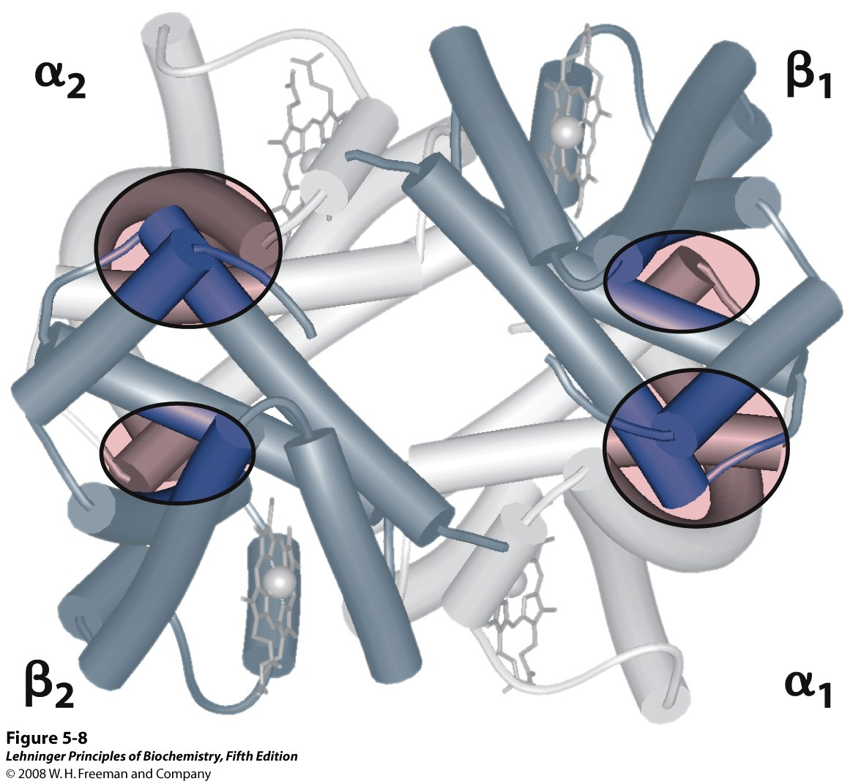
Hemoglobin – O₂ carrier

Slide 7
Protein classification by function
Enzymes: catalyze chemical reactions.
Regulatory proteins: bind to protein receptors, e.g. hormones such as insulin.
Transport proteins: e.g. myoglobin and hemoglobin transport O₂.
Storage proteins: e.g. casein in milk, ovalbumin in eggs.
Contractile and motile proteins: involved in motion, e.g. myosin and actin in muscle.

Slide 8
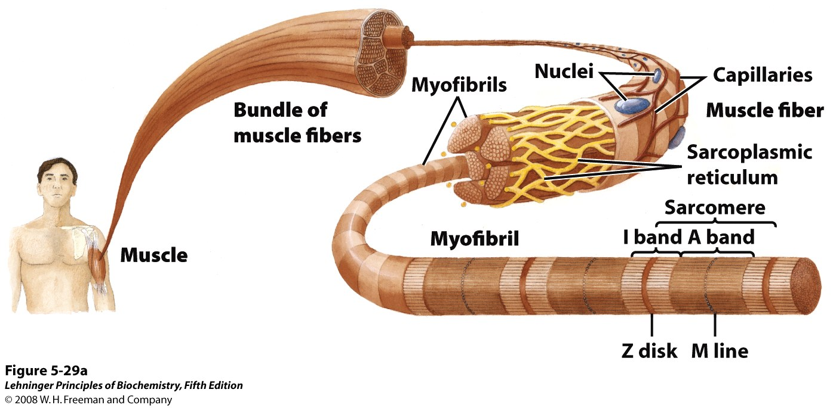
The major proteins of muscle are myosin and actin

Slide 9
Protein classification by function
Enzymes: catalyze chemical reactions.
Regulatory proteins: bind to protein receptors, e.g. hormones such as insulin.
Transport proteins: e.g. myoglobin and hemoglobin transport O₂.
Storage proteins: e.g. casein in milk, ovalbumin in eggs.
Contractile and motile proteins: involved in motion, e.g. myosin and actin in muscle.
Structural proteins: e.g collagen, keratins (in skin, hair), elastin (vocal chord, arteries), silk.
Binding/Interaction proteins: proteins bind one another only when a signal is received, e.g. phosphorylation of Insulin Receptor Substrate (IRS) protein.
Protective proteins: e.g. immunoglobulins, proteins of blood clotting system.
Notes:
80% of protein in cow’s milk if casein. Ovalbumin is the main protein found in egg white, making up 60-65% of the total protein.

Slide 10
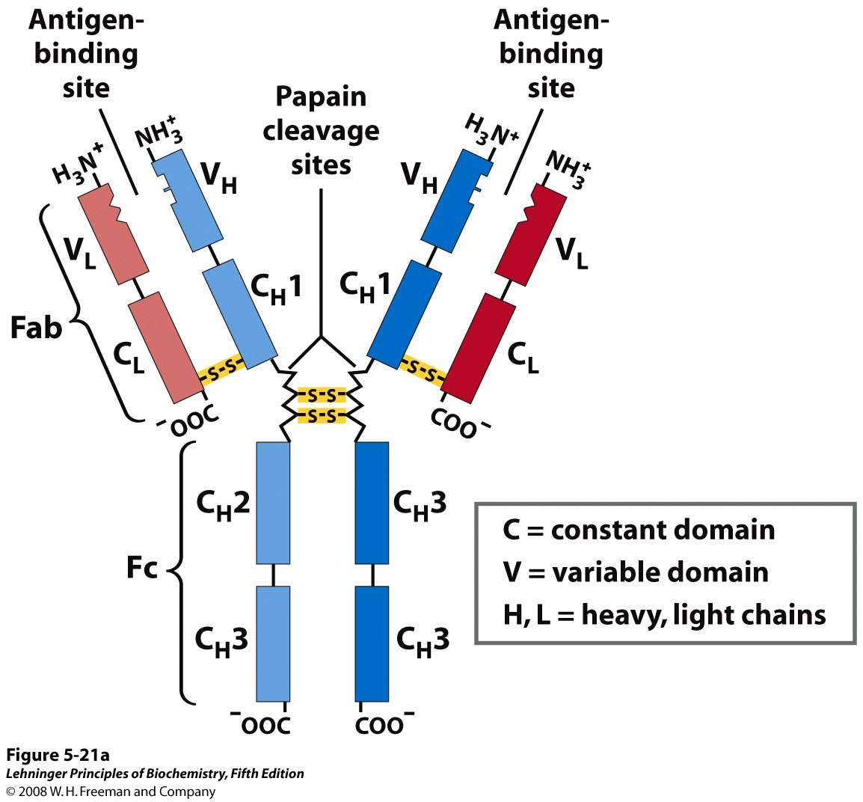
Antibodies recognize antigens
Notes:
Immunoglobulin G. (a) Pairs of heavy and light chains combine to form a Y-shaped molecule. Two antigen-binding sites are formed by the combination of variable domains from one light (V_{L}) and one heavy (V_{H}) chain. Cleavage with papain separates the Fab and Fc portions of the protein in the hinge region. The Fc portion of the molecule also contains bound carbohydrate (shown in (b)).

Slide 11
Enzymes – Biological catalysts
First discovered by Eduard Buchner in 1897 who observed that yeast extracts can ferment sugar to alcohol. Nobel Prize 1907.
This proved that fermentation was promoted by molecules that continued to function when removed from cells.
The first enzyme to be purified and crystallized was urease in 1926 by James Sumner at Cornell University; these crystals consisted entirely of protein. Nobel Prize 1946.
Later, pepsin, trypsin and other digestive proteins were isolated and determined to be purely protein as well.

Slide 12
Enzymes
Enzymes are the catalysts of nature.
With the exception of catalytic RNA, all enzymes are proteins.
Catalysts alter the rate of a chemical reaction without undergoing a permanent change in structure
Catalytic activity is dependent upon native (i.e. folded) conformation of the enzyme; if it is lost, then catalytic activity is lost as well.
All levels of protein architecture (i.e. primary to quaternary structure) must be intact and correct for enzymes to perform their functions.
They range in molecular weights from 12,000 to over 1 million daltons.

Slide 13
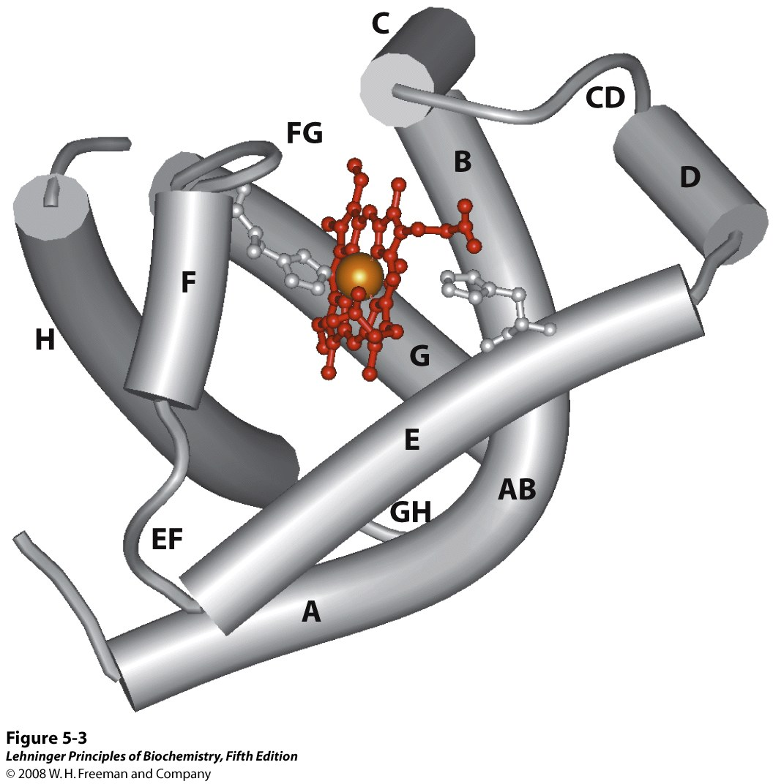
Enzymes
Most enzymes are proteins.
Simple Enzymes: composed of whole proteins.
Complex Enzymes: composed of protein plus a relatively small organic molecule.
Holoenzyme = apoenzyme + prosthetic group or coenzyme

Slide 14
Enzymes
Most enzymes are proteins.
Simple Enzymes: composed of whole proteins.
Complex Enzymes: composed of protein plus a relatively small organic molecule.
Holoenzyme = apoenzyme + prosthetic group or coenzyme
A prosthetic group describes a small organic or metalloorganic molecule bound to the apoenzyme by covalent bonds.
When the binding between the apoenzyme and non-protein components is non-covalent, the small organic molecule is called a coenzyme.
Coenzymes serve as transient carriers of specific functional groups.
They often come from vitamins (organic nutrients required in small amounts that we obtained from the diet)

Slide 15
International Classification of Enzymes
Oxidoreductases | Add or remove hydrogen atoms (transfer of electrons).
Transferases | Transfer functional groups between donor and acceptor molecules. E.g. Kinases transfer phosphate group from ATP to other molecules.
Hydrolases | Catalyze hydrolysis i.e. breaking of a bond by the addition of a water molecule.
Lyases | Add water, ammonia or carbon dioxide across double bonds, or remove these elements to produce double bonds.
Isomerases | Carry out many kinds of isomerization. E.g. L to D isomerizations, mutase reactions (shifts of chemical groups) and cis-trans isomerization of peptide bonds.
Ligases | Catalyze reactions in which two chemical groups are joined (or ligated) with the use of energy from ATP.

Slide 16
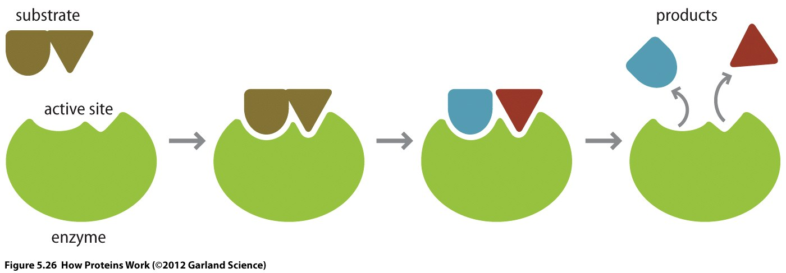
How enzymes work
Enzymes catalyze chemical reactions that do not normally proceed under conditions such as neutral pH, mild temperature, and aqueous solvent
The site of catalytic activity on the enzyme is known as the active site
The molecule that binds to the active site and is acted upon by the enzyme is called the substrate
The two together form what is known as the enzyme-substrate complex
The function of an enzyme is to increase the rate of a chemical reaction without affecting its equilibrium
Therefore, enzymes don’t make more product, they just make product faster
enzyme-substrate complex

Slide 17
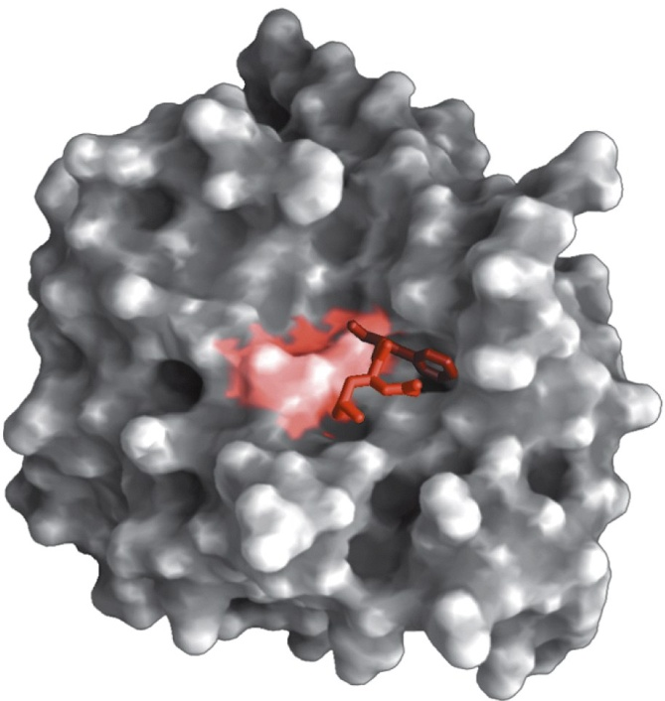
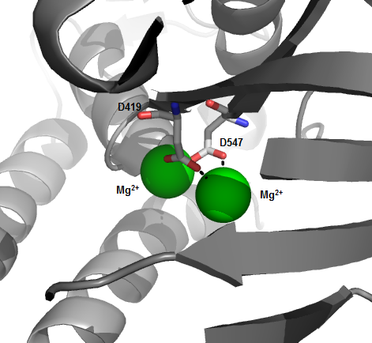
Active Site
Chymotrypsin
The area of an enzyme where the substrate binds
Structure has a unique geometric shape that is designed to fit the molecular shape of the substrate
Active sites contain residues that bind the substrate and also participate in catalysis
Active sites sometimes contain a co-factor
Active site residues have several important properties:
Charge (partial, dipoles)
pKa
Hydrophobicity
Flexibility
DNA Polymerase
Notes:
Binding of a substrate to an enzyme at the active site. The enzyme chymotrypsin, with bound substrate in red (PDB ID 7GCH). Some key active-site amino acid residues appear as a red splotch on the enzyme surface. Chymotrypsin cleaves a peptide bond that has a big hydrophobic group sidechain (such as Phe, Tyr and Trp) in its carboxy end.

Slide 18
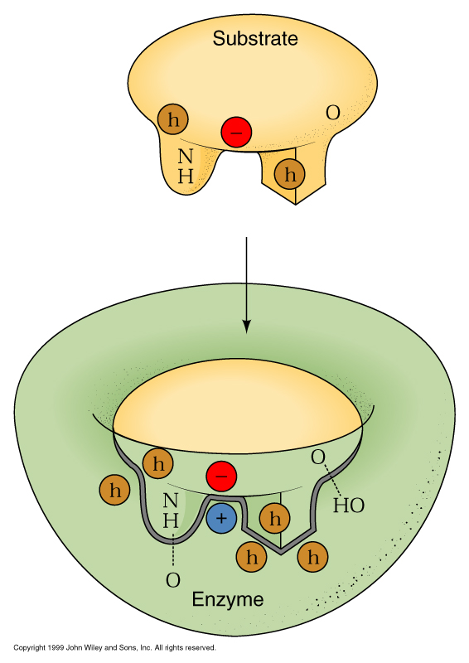
Substrate Binding site (Active site)
Complementarity:
Geometric
Electronic (electrostatic)
Stereospecificity (enzymes and substrates are chiral)
Models of enzyme action:
Lock and Key model
Induced Fit model
Notes:
18

Slide 19
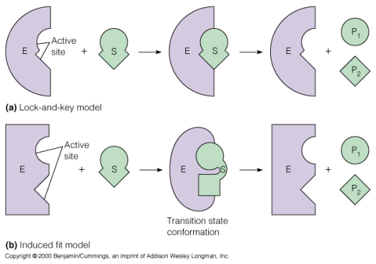
Models of enzyme action
Lock and Key Model
An enzyme binds a substrate in a region called the active site
The active site shape is complementary to the substrate i.e. not all substrates can fit the active site
Amino acid sidechains in the active site bind the substrate

Slide 20
Models of enzyme action
Induced Fit Model
Enzyme structure is flexible, not rigid
Enzyme and active site adjust their shape to bind the substrate.
Increases range of substrate specificity
Shape changes also improve catalysis during reaction - by stabilizing the transition-state

Slide 21
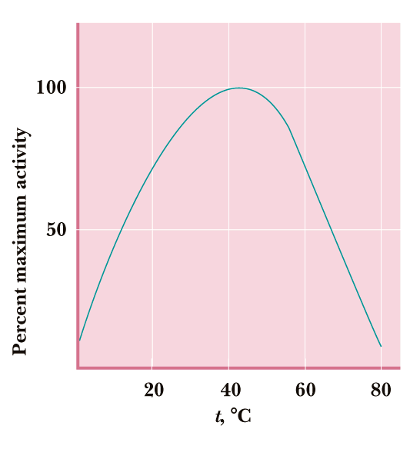
Factors that influence enzyme activity: temperature
Notes:
With increase in temperature reactions get faster but the enzyme catalyzing the reaction may start unfolding. Hence, most enzymes have an optimal temperature range for their function. Since, our body temperature is 37C, most enzymes in our body work optimally in the 30C to 40C temperature range. Another example is thermophilic bacteria. They live in high temperature regions such as hot springs and their enzymes are stable even when boiled. One such thermostable DNA polymerase enzyme (called Taq Polymerase) is used in PCR, which works optimally at ~ 70C.

Slide 22
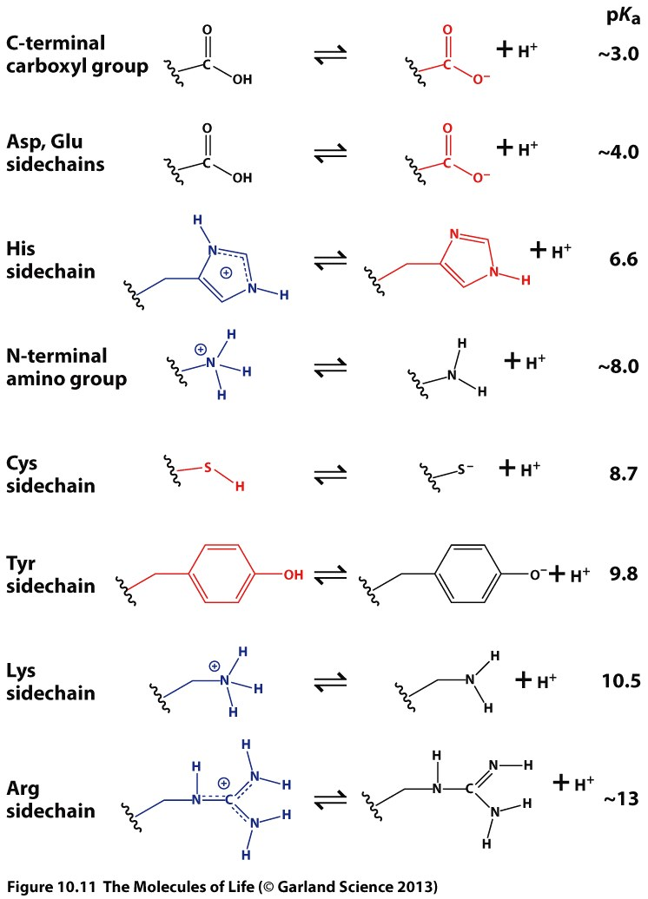
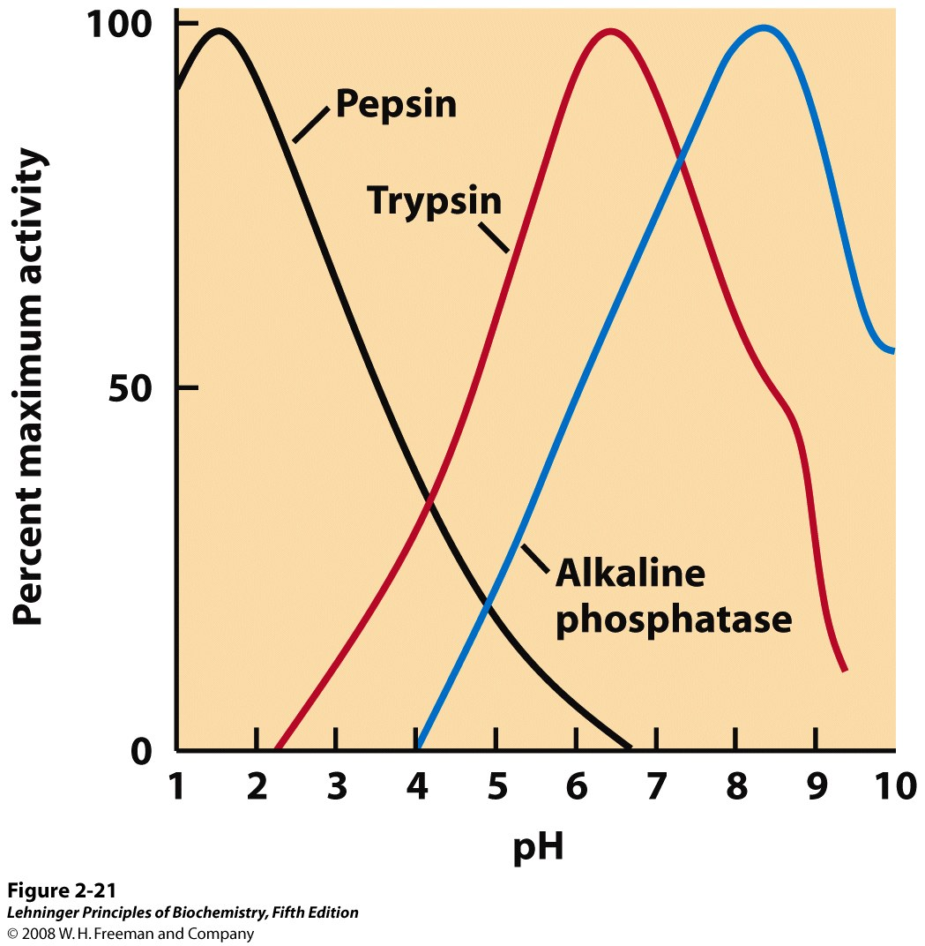
Factors that influence enzyme activity: pH
Notes:
The pH optima of some enzymes. Pepsin is a digestive enzyme secreted into gastric juice, which has a pH of ~1.5, allowing pepsin to act optimally. Trypsin, a digestive enzyme that acts in the small intestine, has a pH optimum that matches the neutral pH in the lumen of the small intestine. Alkaline phosphatase of bone tissue is a hydrolytic enzyme thought to aid in bone mineralization.

Slide 23
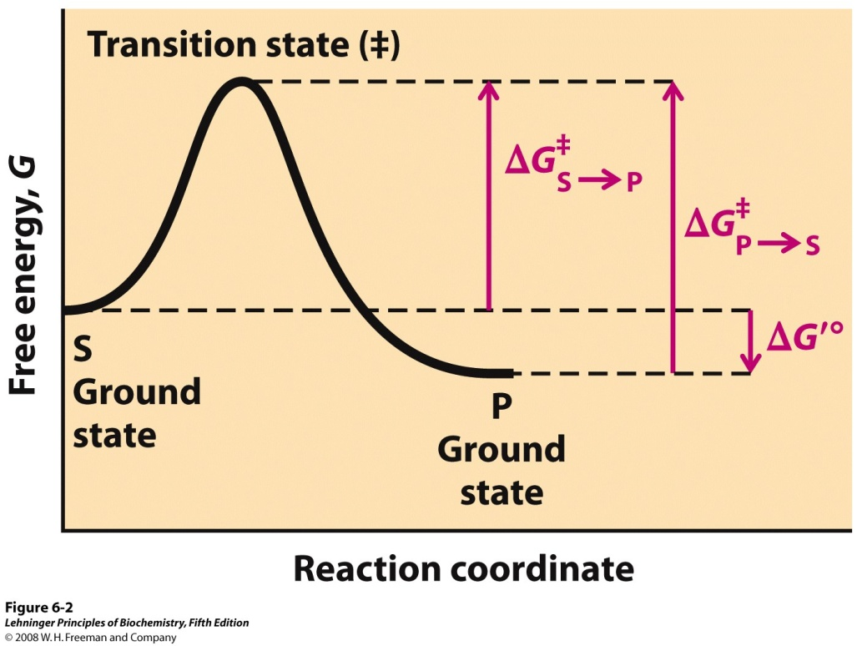
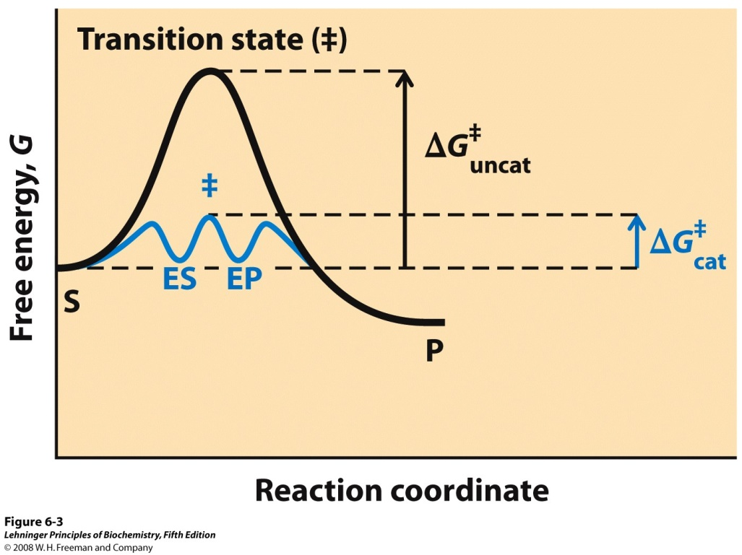
How enzymes work?
ΔG^{ǂ} _{S→P}for uncatalyzed reaction = 107 kJ
ΔG^{ǂ} _{cat} for catalyzed reaction = 47 kJ
k_{uncat} ∝ e^{-107000/8.314x298}
k_{cat} ∝ e^{-47000/8.314x298}
k_{cat}/k_{uncat} = ~5x10¹⁰
ǂ
k ∝ e^{-ΔG /RT}
1 sec
~1500 years
Notes:
Reaction coordinate diagram. The free energy of the system is plotted against the progress of the reaction S → P. A diagram of this kind is a description of the energy changes during the reaction, and the horizontal axis (reaction coordinate) reflects the progressive chemical changes (e.g., bond breakage or formation) as S is converted to P. The activation energies, ΔG˚, for the S → P and P → S reactions are indicated. ΔG′˚ is the overall standard free-energy change in the direction S → P.
Reaction coordinate diagram comparing enzyme-catalyzed and uncatalyzed reactions. In the reaction S → P, the ES and EP intermediates occupy minima in the energy progress curve of the enzyme-catalyzed reaction. The terms ΔG‡_{uncat} and ΔG‡_{cat} correspond to the activation energy for the uncatalyzed reaction and the overall activation energy for the catalyzed reaction, respectively. The activation energy is lower when the enzyme catalyzes the reaction.

Slide 24
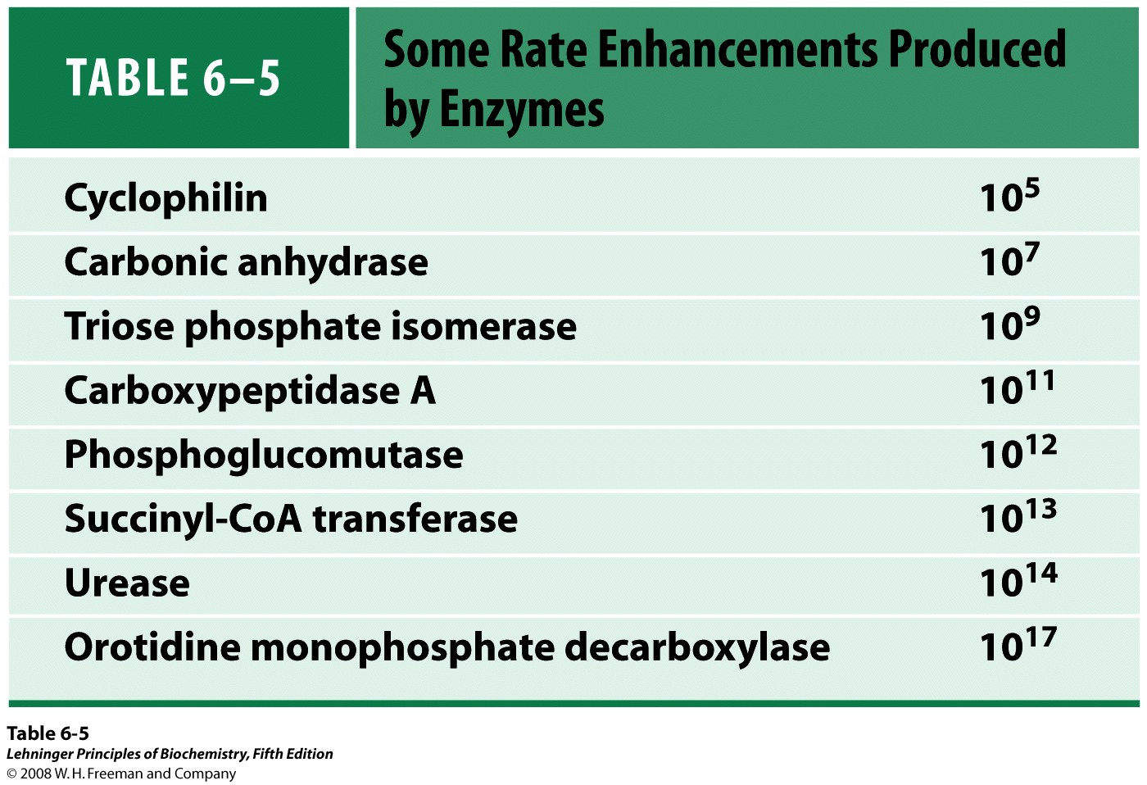

Slide 25
How can an enzyme reduce the activation energy?
(1) Binding to the substrate can be done such that the formation of the transition state is favored
(2) Orientation and positioning of substrate(s)
(3) Bonds in the substrate can be ‘activated’ by functional groups in the catalytic site

Slide 26
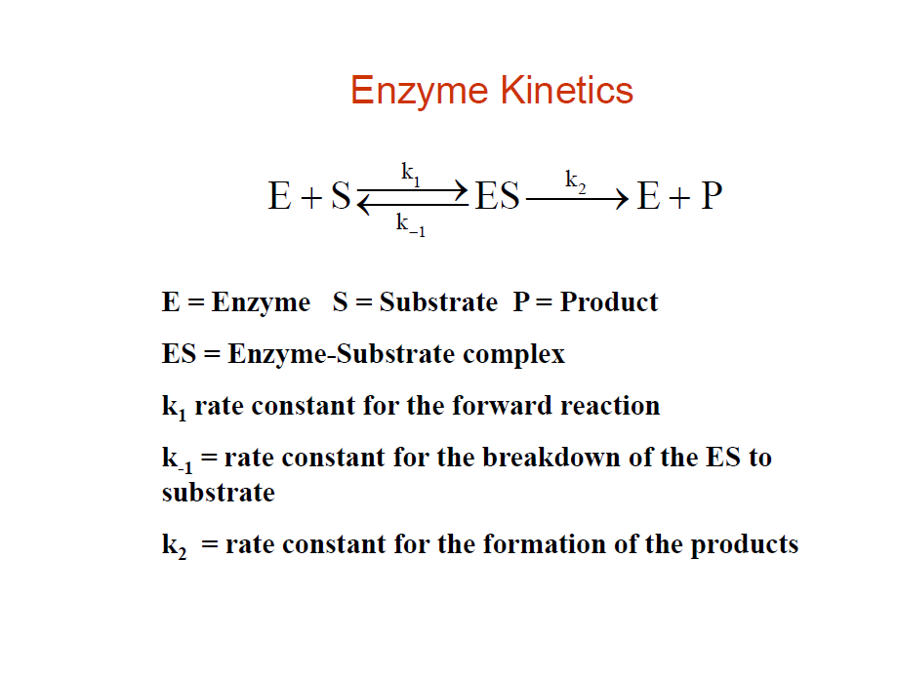

Slide 27
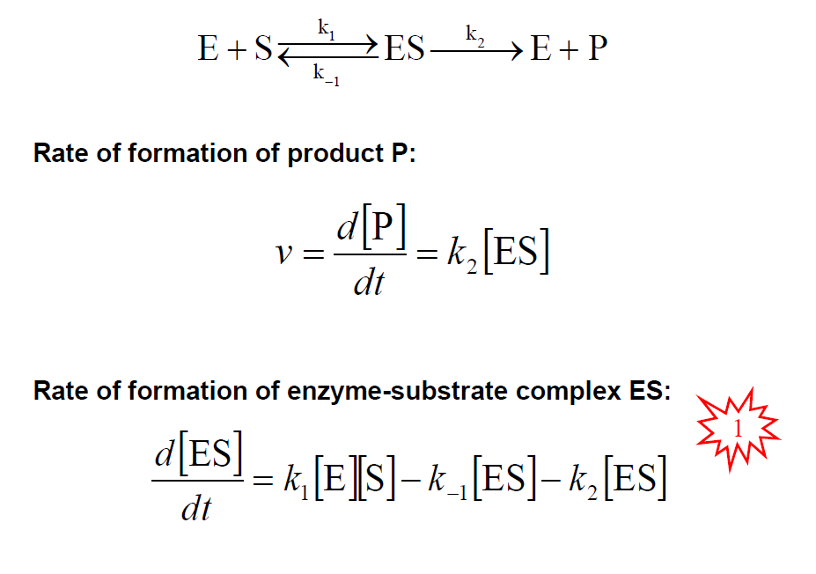

Slide 28
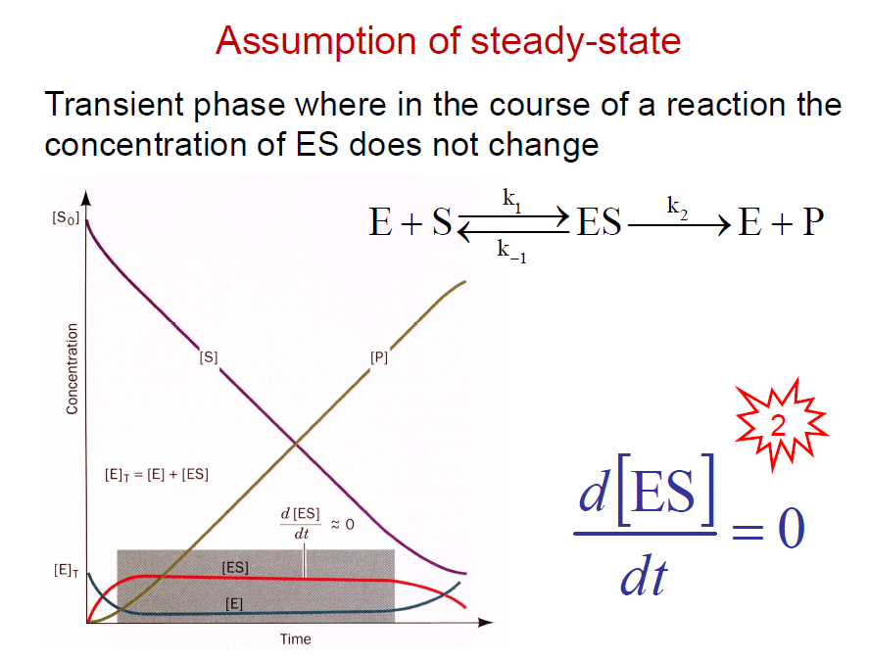

Slide 29
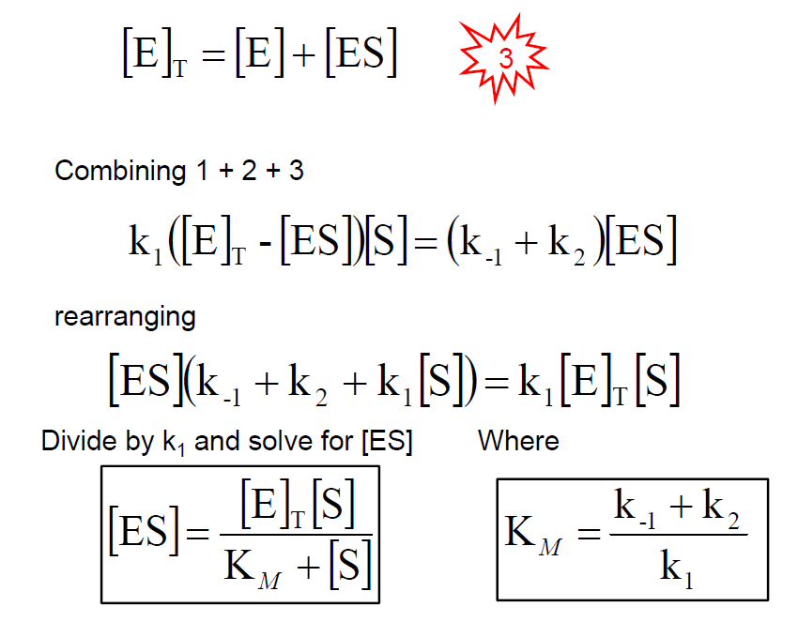

Slide 30
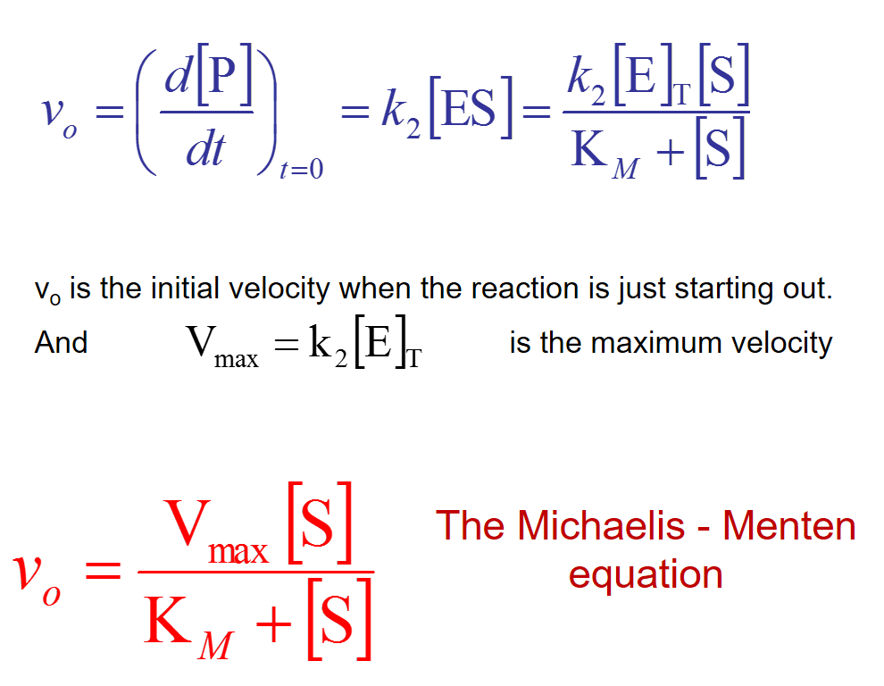

Slide 31
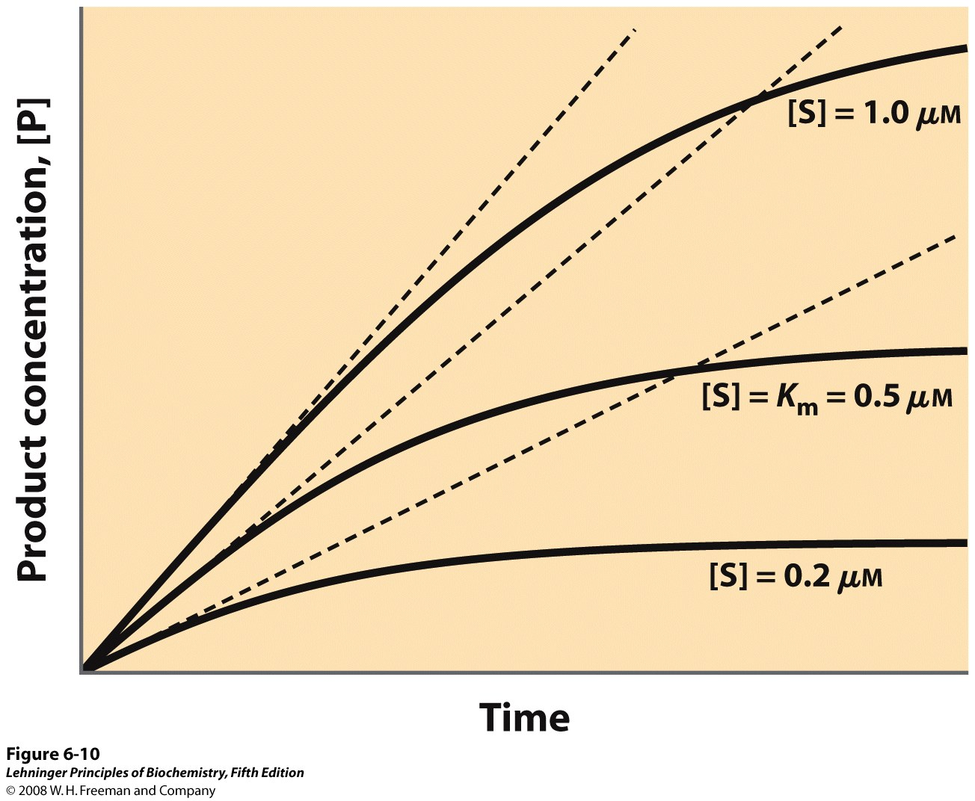
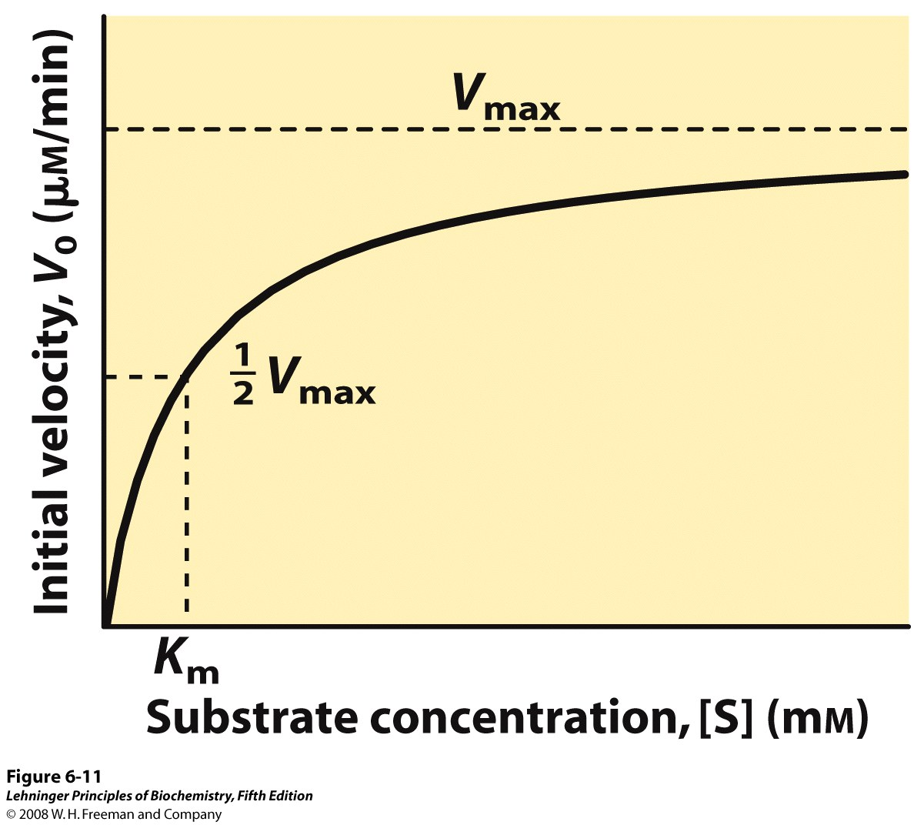
Michaelis – Menten Kinetics
The K_{m} is the substrate concentration where v_{o} equals one-half V_{max}
Notes:
Initial velocities of enzyme-catalyzed reactions. A theoretical enzyme catalyzes the reaction S ↔ P, and is present at a concentration sufficient to catalyze the reaction at a maximum velocity, V_{max}, of 1 μM/min. The Michaelis constant, K_{m} (explained in the text), is 0.5 μM. Progress curves are shown for substrate concentrations below, at, and above the K_{m}. The rate of an enzyme-catalyzed reaction declines as substrate is converted to product. A tangent to each curve taken at time = 0 defines the initial velocity, V₀, of each reaction.
Effect of substrate concentration on the initial velocity of an enzyme-catalyzed reaction. The maximum velocity, V_{max}, is extrapolated from the plot, because V₀ approaches but never quite reaches V_{max}. The substrate concentration at which V₀ is half maximal is K_{m}, the Michaelis constant. The concentration of enzyme in an experiment such as this is generally so low that [S] >> [E] even when [S] is described as low or relatively low. The units shown are typical for enzyme-catalyzed reactions and are given only to help illustrate the meaning of V₀ and [S]. (Note that the curve describes part of a rectangular hyperbola, with one asymptote at V_{max}. If the curve were continued below [S] = 0, it would approach a vertical asymptote at [S] = –K_{m}.)

Slide 32
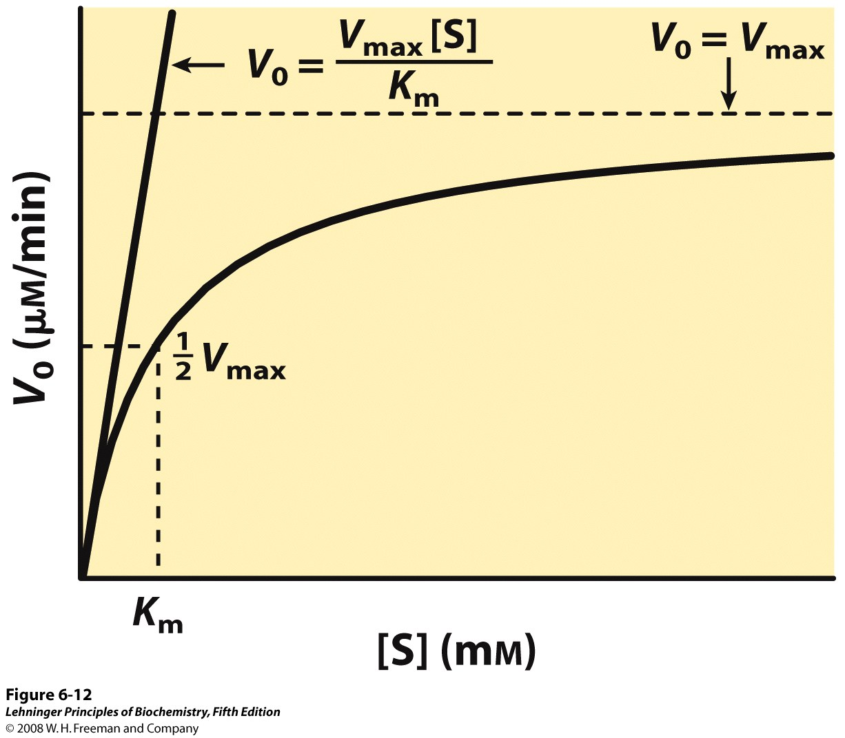
Michaelis – Menten Kinetics
low [S], v is proportional to [S] - first order high [S], v is independent of [S] - zero order
Notes:
Dependence of initial velocity on substrate concentration. This graph shows the kinetic parameters that define the limits of the curve at high and low [S]. At low [S], K_{m} >> [S] and the [S] term in the denominator of the Michaelis-Menten equation (Eqn 6-9) becomes insignificant. The equation simplifies to V₀ = V_{max}[S]/K_{m} and V₀ exhibits a linear dependence on [S], as observed here. At high [S], where [S] >> K_{m}, the K_{m} term in the denominator of the Michaelis-Menten equation becomes insignificant and the equation simplifies to V₀ = V_{max}; this is consistent with the plateau observed at high [S]. The Michaelis-Menten equation is therefore consistent with the observed dependence of V₀ on [S], and the shape of the curve is defined by the terms V_{max}/K_{m} at low [S] and V_{max} at high [S].

Slide 33
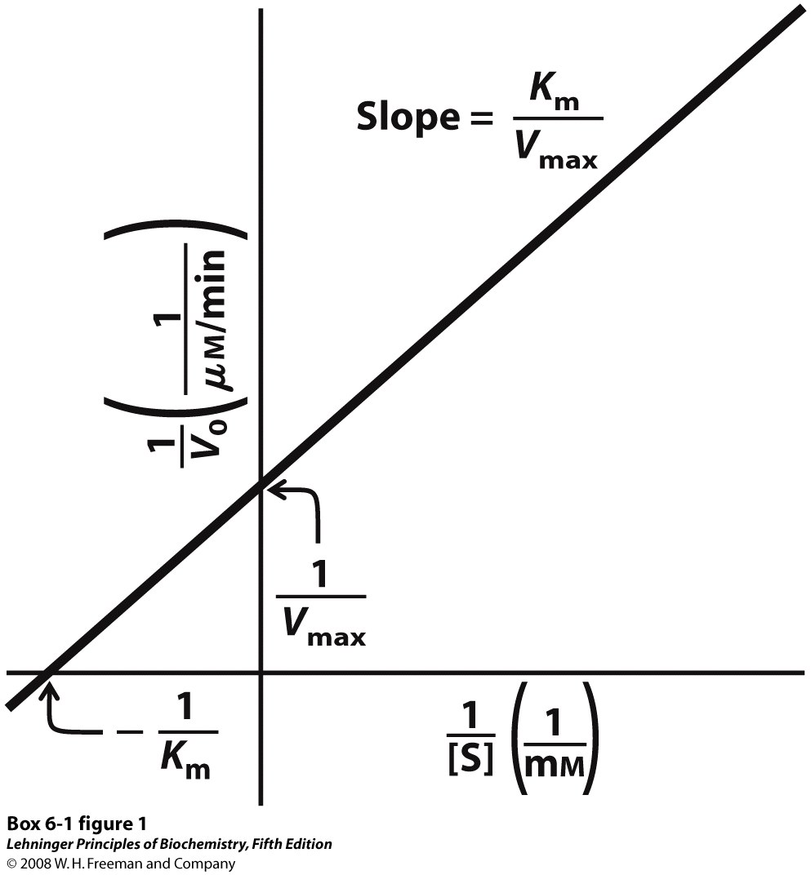
Lineweaver-Burk Plot
The double reciprocal plot
Lineweaver-Burk plot transforms the Michaelis-Menten equation into linear form.
V₀ = V_{max} [S]
K_{m} + [S]
1 = K_{m} + [S]
V₀ V_{max} [S]
1
V₀
K_{m} 1 1
V_{max} [S] V_{max}
=
+
(y = mx + c)
Notes:
A double-reciprocal or Lineweaver-Burk plot.

Slide 34
The turnover number (k_{cat})
k_{cat} is how many reactions an enzyme can catalyze per second
V₀ = V_{max} [S]
K_{M} + [S]
For Michaelis - Menten kinetics k₂= k_{cat}
When [S] << K_{M} very little ES is formed and [E] = [E]_{T}
and
k_{cat}/K_{M} is a measure of catalytic efficiency
Notes:
34

Slide 35
K_{M}
Relates to how strongly an enzyme binds its substrate.
High K_{M} means strength of binding is low.
k_{cat}
Relates to how rapid a catalyst the enzyme is.
High k_{cat} means high speed of catalysis.
V_{max}
Related to k_{cat} and [E_{T}] by: V_{max}=k_{cat}[E_{T}]
High V_{max} means high rate of catalysis.

Slide 36
k_{cat} = turnover number; k_{cat} = V_{max}/[E_{T}]
k_{cat}/K_{m} is a measure of activity, catalytic efficiency
K_{M} is a useful indicator of the affinity of an enzyme for the substrate
A low K_{M} indicates a high affinity for the substrate
A high k_{cat}/K_{M} ratio implies an efficient enzyme
This could result from: Large k_{cat}
Small K_{M}

Slide 37
Enzyme Inhibition
Inhibitors: compounds that decrease or eliminate activity of an enzyme.
Can decrease binding of substrate (affect K_{M}), or turnover number (affect k_{cat}) or both.
Most drugs are enzyme inhibitors.
Inhibitors are also important for determining enzyme mechanisms and the nature of the active site.
Some examples of enzyme inhibitors:
Antibiotics inhibit enzymes by affecting bacterial metabolism.
Nerve Gases cause irreversible enzyme inhibition.
Insecticides – choline esterase inhibitors.
Many heavy metal poisons work by irreversibly inhibiting enzymes, especially cysteine residues.
Notes:
37

Slide 38
Types of Enzyme Inhibition
Reversible inhibition
reversibly bind and dissociate from enzyme, activity of enzyme recovered on removal of inhibitor - usually non-covalent in nature
Competitive
Uncompetitive
Noncompetitive
Irreversible inhibition
irreversibly associate with enzyme. Activity of enzyme not recovered on removal - usually covalent in nature.

Slide 39
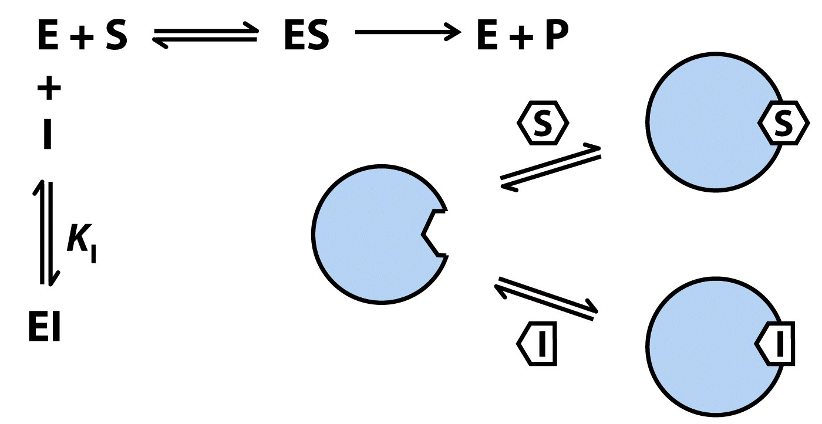
Competitive Inhibition
Inhibitor competes for the substrate binding site
most look like substrate
substrate mimic / substrate analogue
Notes:
39
Competitive inhibitors bind to the enzyme's active site; K_{I} is the equilibrium constant for inhibitor binding to E.

Slide 40
Competitive Inhibition
1
V₀
K_{m} 1 1
V_{max} [S] V_{max}
=
+
(y = mx + c)
Notes:
40
A double-reciprocal or Lineweaver-Burk plot.

Slide 41
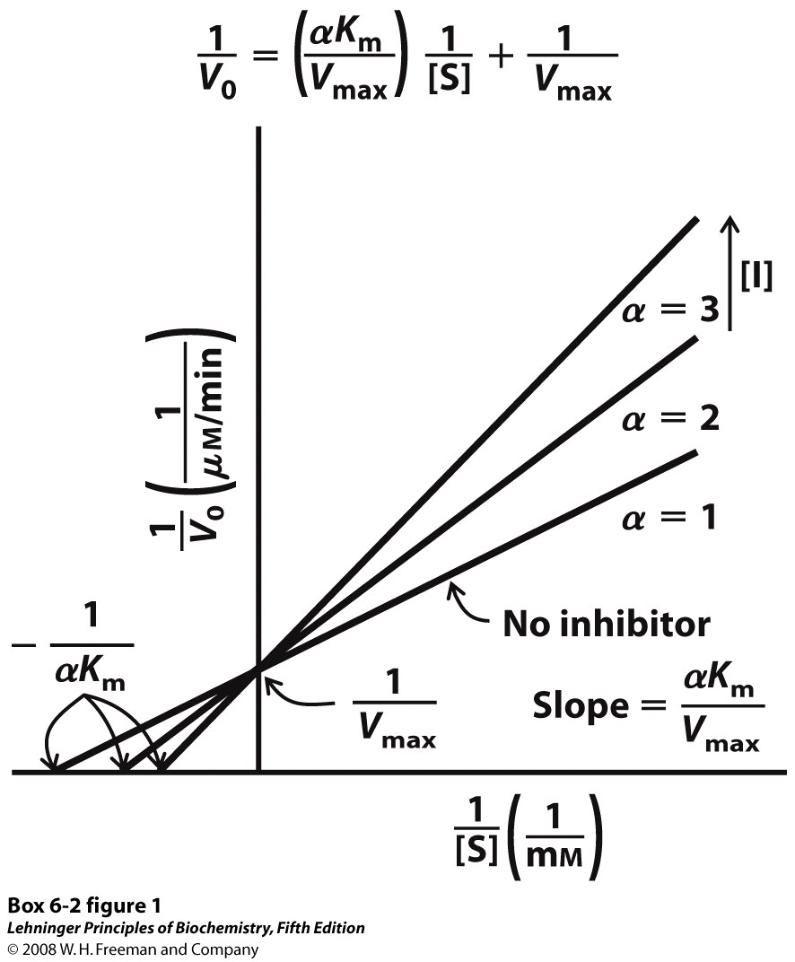
Competitive Inhibition
1
V₀
K_{m} 1 1
V_{max} [S] V_{max}
=
+
(y = mx + c)
α = 1 + [I]/K_{i}
Notes:
41

Slide 42
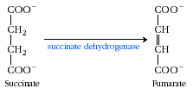
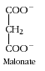
Competitive Inhibition: examples
1.
No Reaction
2. Methanol poisoning is treated with ethanol: Methanol itself is only mildly toxic, but the liver enzyme alcohol dehydrogenase converts methanol into highly toxic formaldehyde. Ethanol competes with methanol, thus, formaldehyde production is slowed and spread out over a longer period of time, lessening its effects on the body.
Notes:
42

Slide 43
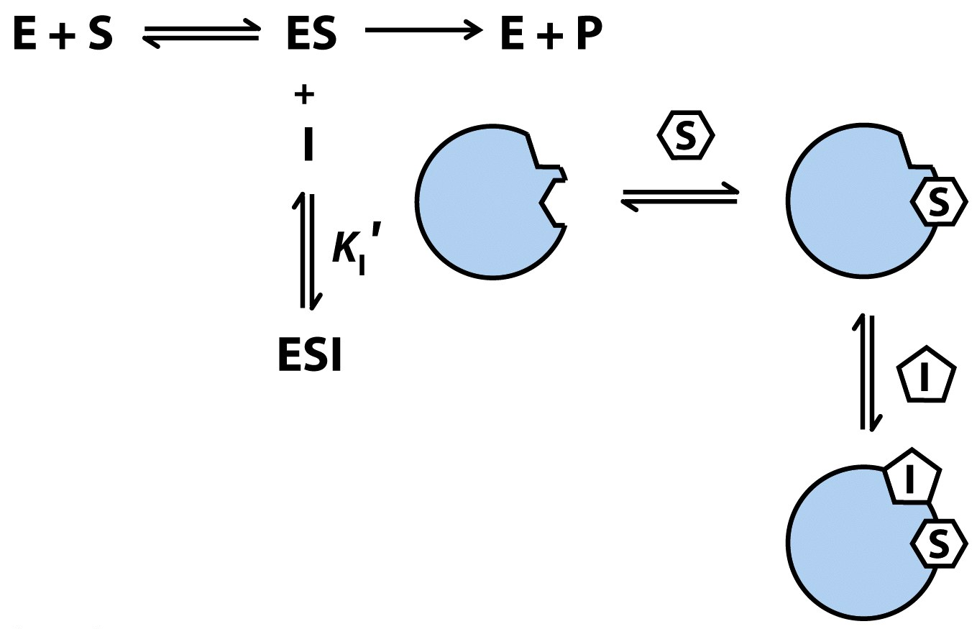
Uncompetitive Inhibition
Uncompetitive inhibitors bind at a site distinct from the substrate active site and bind only to the ES complex
Notes:
43
Uncompetitive inhibitors bind at a separate site, but bind only to the ES complex; K_{I}′ is the equilibrium constant for inhibitor binding to ES.

Slide 44
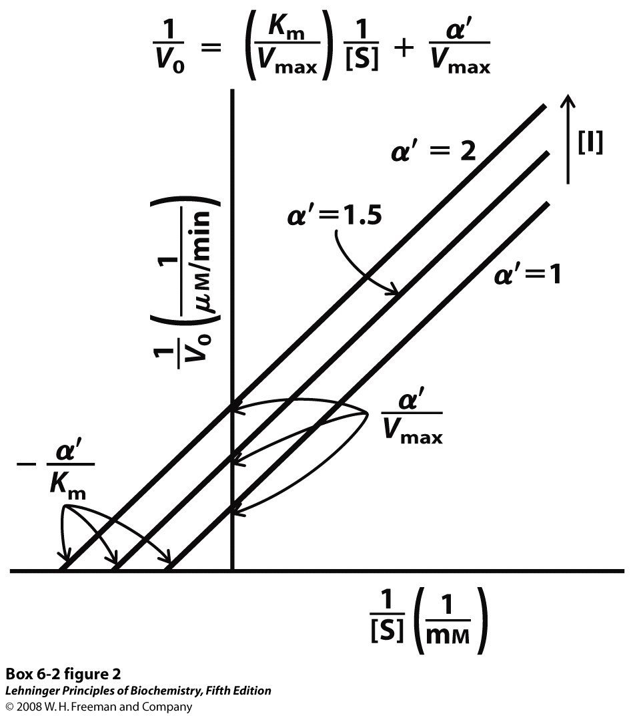
Uncompetitive Inhibition
1
V₀
K_{m} 1 1
V_{max} [S] V_{max}
=
+
(y = mx + c)
α’ = 1 + [I]/K’_{i}
Notes:
44

Slide 45
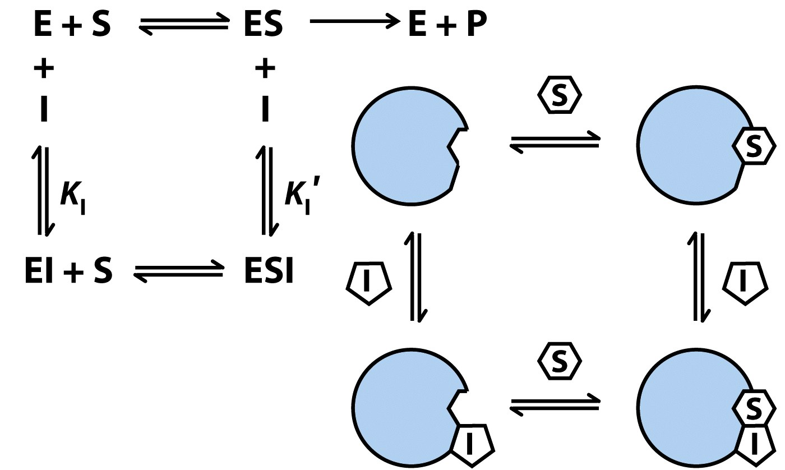
Non-competitive Inhibition
Inhibitor can bind at a site distinct from the substrate active site to either E or ES.
V_{o}
= V_{max}[S]/(αK_{M} + α’[S])
V_{max} decreases; K_{M} can go up or down.
Notes:
45
Mixed inhibitors bind at a separate site, but may bind to either E or ES

Slide 46
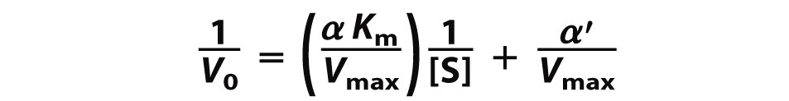
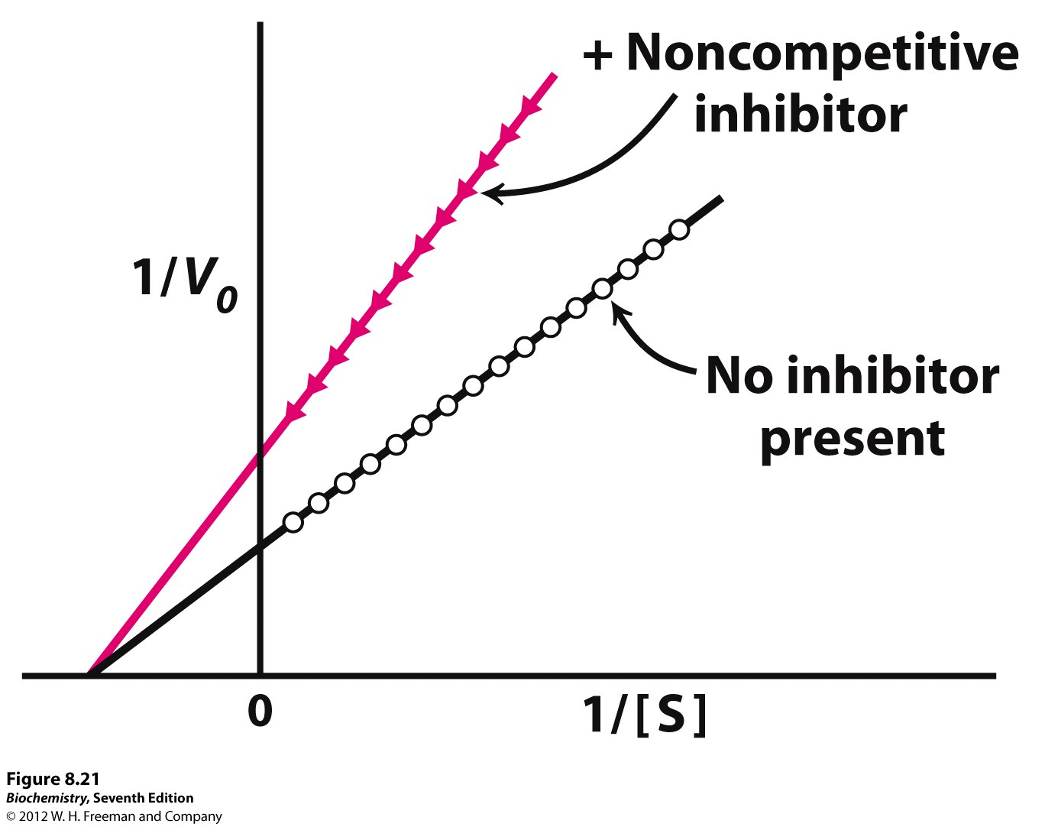
Non-competitive Inhibition
1
V₀
K_{m} 1 1
V_{max} [S] V_{max}
=
+
(y = mx + c)
Notes:
46

Slide 47
Allosteric regulation of enzymes
A small molecule that can bind an enzyme and act as an effector or regulator to activate or inactivate its function.
In such case, the protein is said to be under allosteric control. If the binding of the small molecule (ligand) is distant from the protein’s active site and regulation is a result of a conformational change in the protein when the ligand is bound, the regulation is called allosteric regulation.
Many types of proteins show allosteric control:
- various gene-regulating proteins (transcription factors) e.g. Lac repressor.

Slide 48
The switch: Allosteric inhibition
Allosteric means “other site”
Active site
E
Allosteric site
Notes:
48

Slide 49
Allosteric inhibition: Switching off the enzyme
These enzymes have two receptor sites-
The active site fits the substrate like other enzymes
The allosteric site fits an inhibitor molecule
Substrate
cannot fit into the active site
Inhibitor sits on allosteric site
Notes:
49

Slide 50
Allosteric inhibition: Switching off the enzyme
Substrate fits into the active site
Active site
Inhibitor molecule is present
E
Allosteric site empty
Conformational change
E
Substrate
cannot fit into the active site
The inhibitor molecule is absent
Inhibitor fits into allosteric site
Notes:
50

Slide 51
Conformational change: Change in shape of the protein
When the inhibitor is present it fits into its site and there is a conformational change in the enzyme molecule
The enzyme’s molecular shape changes
The active site of the substrate changes
The substrate cannot bind with the enzyme
Notes:
51

Slide 52
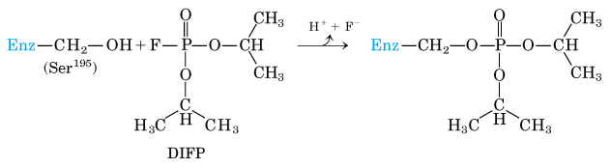
Irreversible inhibition: Kill the enzyme
Irreversible inhibitors are those that combine with or destroy a functional group on an enzyme that is essential for activity
They usually form covalent linkages to the enzyme
Diisopropylfluorophosphate binds irreversibly with Chymotrypsin at the Ser195 residue; this gives info justifying this as the primary active site of the enzyme

Slide 53
A special class of irreversible inhibitors is the suicide inactivators
These are unreactive until bound to the active site
They are designed to carry out the first few steps of a normal enzyme reaction, but instead of forming a product, they form a highly reactive compound that binds irreversibly to the enzyme
They are sometimes called mechanism-based inactivators, because they use the normal enzyme mechanism to lead to the inactivation
These are often used in drug design

Slide 54
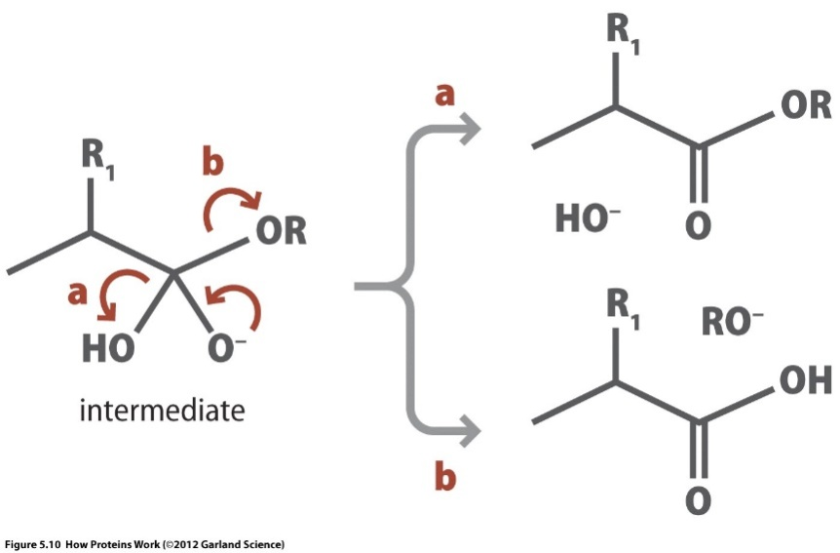
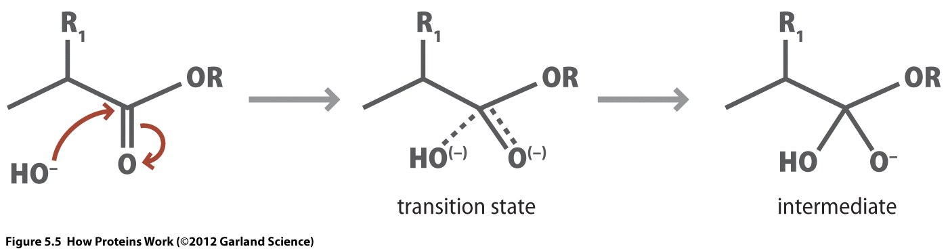
How enzymes work? Example: Chymotrypsin
Chymotrypsin is a digestive enzyme component of pancreatic juice.
It performs proteolysis i.e. the breakdown of proteins and polypeptides.
Chymotrypsin preferentially cleaves peptide amide bonds where the carboxyl side of the amide bond is an aromatic amino acid (tyrosine, tryptophan, and phenylalanine).
N
N
N
N
N
N
Chymotrypsin facilitates the nucleophilic (OH⁻) attack from the correct orientation.
It lowers the transition state energy.
Chymotrypsin favors reaction ‘b’ after formation of the intermediate.

Slide 55
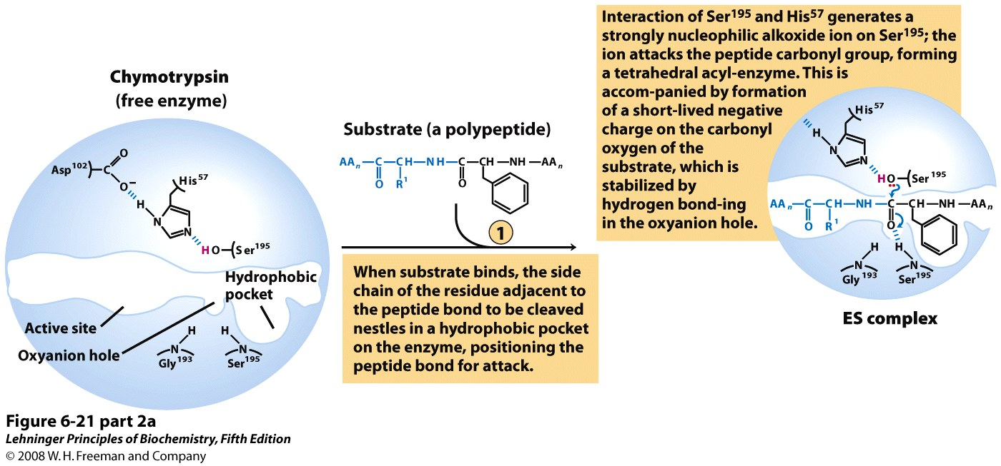
How enzymes work? Example: Chymotrypsin

Slide 56
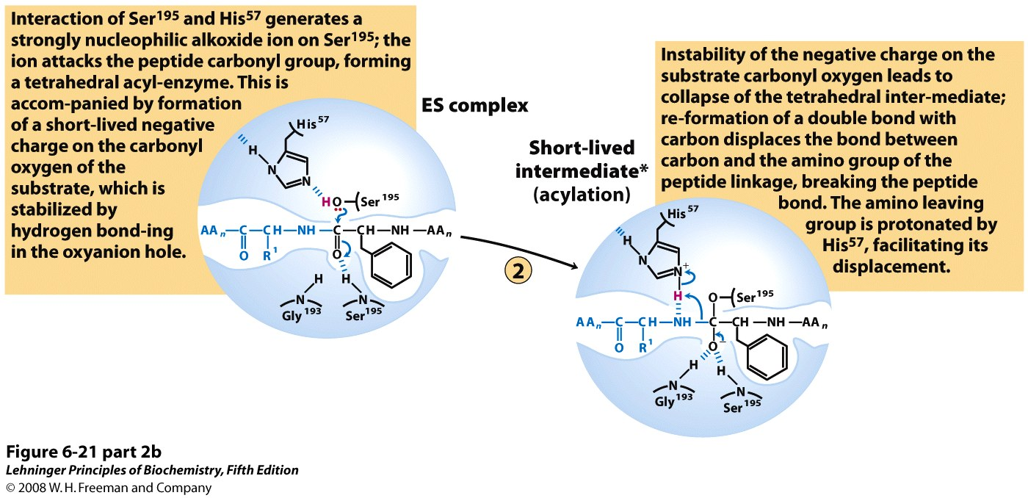
How enzymes work? Example: Chymotrypsin
Notes:
FIGURE 6-21 (part 2b) Hydrolytic cleavage of a peptide bond by chymotrypsin. The reaction has two phases. In the acylation phase (steps 1 to 3), formation of a covalent acyl-enzyme intermediate is coupled to cleavage of the peptide bond. In the deacylation phase (steps 4 to 7), deacylation regenerates the free enzyme; this is essentially the reverse of the acylation phase, with water mirroring, in reverse, the role of the amine component of the substrate.

Slide 57
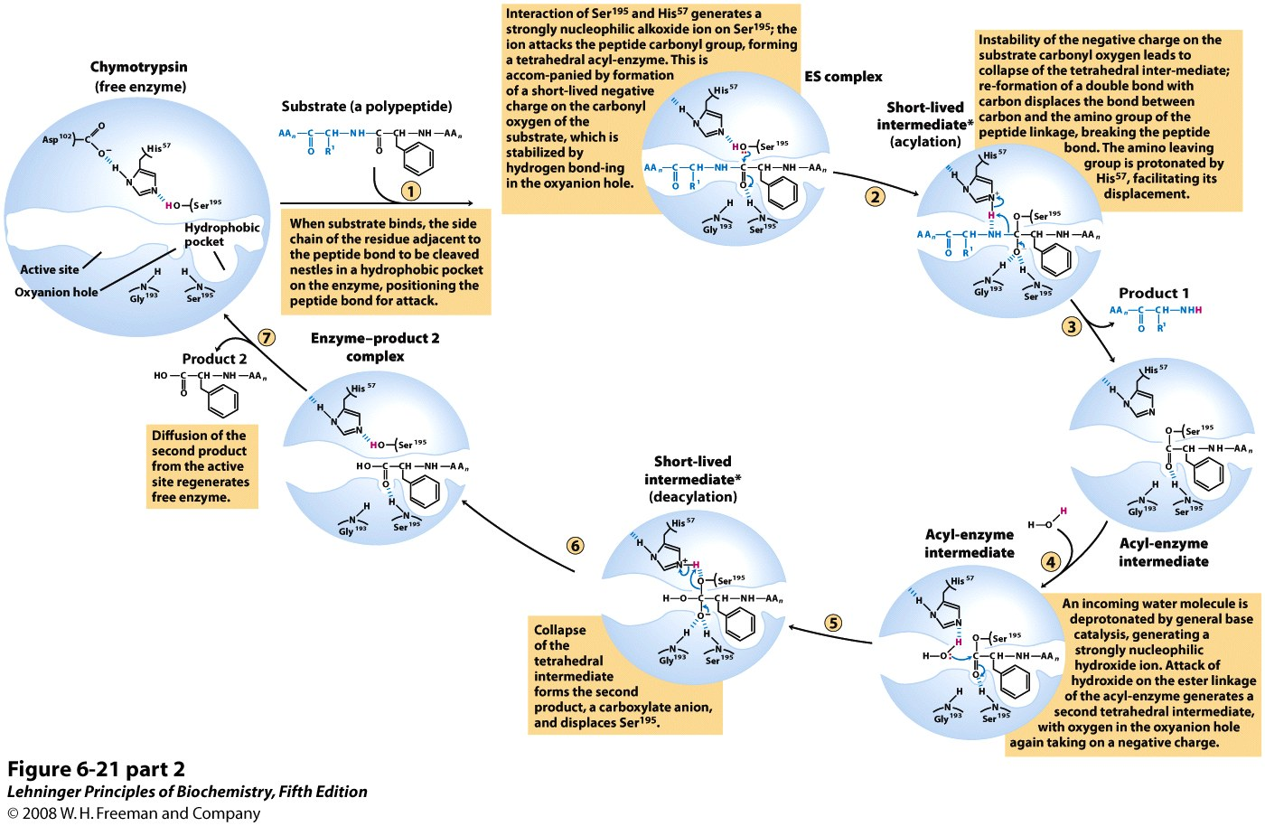
How enzymes work? Example: Chymotrypsin

